Slide 1
Understanding Cryptology
Core Concepts
Dr. Kerry A. McKay
Approved for Public Release. Distribution Unlimited 13-1379

Slide 2
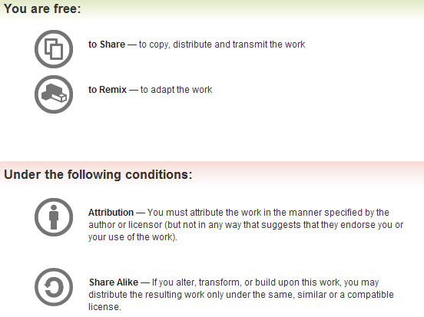
All materials is licensed under a Creative Commons “Share Alike” license.
http://creativecommons.org/licenses/by-sa/3.0/

Slide 3
Goals
Provide an accessible introduction to cryptology
No math degree required
Provide abstract ideas
Understand form of many algorithms rather than details of just a few
Cover a little of everything
Lay groundwork for deeper study in specialized areas

Slide 4
Day 1
Overview of cryptology
Introduction to cryptography
A high level view of cryptography and cryptanalysis
Symmetric cryptography
Asymmetric cryptography
Additional primitives

Slide 5
Day 2
Protocols
Cryptanalysis
Case studies
Standardization
Summary and lessons

Slide 6
Administrivia
Sign in
There is some math in here, but I’ve tried to keep it to a minimum
This course was designed with a bachelor’s level computer scientist in mind
If you don’t understand something, just ask! ☺

Slide 7

Recommended reading
Book for course
Understanding Cryptography: A Textbook for Students and Practitioners
Paar and Pelzl
Companion website
http://www.crypto-textbook.com/
Slides developed by authors
Videos

Slide 8



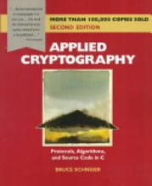
Additional Suggestions
Applied
Theory
Cryptography Engineering
Ferguson, Schneier, Kohno
Applied Cryptography
Schneier
Cryptography: Theory and Practice
Stinson
Introduction to Modern Cryptography
Katz, Lindell

Slide 9
What is Cryptology?
Cryptology is “the scientific study of cryptography and cryptanalysis” (according to Merriam-Webster)
People often say “cryptography” to mean both
Cryptography is the science of secret writing with the goal of hiding the meaning of a message
This is different from steganography, where the presence of the message is hidden
Cryptanalysis is the science and art of breaking cryptosystems

Slide 10
Crypto topics covered in this course
Cryptology
Cryptography
Symmetric
Asymmetric
Cryptanalysis
Protocols
Mathematical
Implementation
Social

Slide 11
Cryptography
Cryptology
Cryptography
Symmetric
Asymmetric
Cryptanalysis
Protocols
Mathematical
Implementation
Social

Slide 12
Cryptography
Cryptography has expanded over the years
Symmetric ciphers
Both encryption and decryption use the same key
Asymmetric ciphers
Different keys for encryption and decryption
Protocols
Inherently cryptographic
Applied cryptography
We’ll talk about each of these more later

Slide 13
What can cryptography do for you?
People sometimes think that adding cryptography makes something secure
Not true
Cryptography can’t solve everything
Buffer overflow, social engineering, malware, etc.
For the problems it can solve, it needs to be used correctly

Slide 14
Cryptography in information assurance
Confidentiality
Prevents unauthorized parties from accessing information
Encryption removes meaning from information
Integrity
Ensures that data cannot be modified without detection
Hash functions make it extremely difficult to change information
Authentication
Ensure that a message was created by a particular party
Key only known by party

Slide 15
Start with a classic
Let’s begin with a concrete example
Caesar (shift) cipher
To do this, we need to take a quick look at modular addition

Slide 16
Modular Arithmetic
What time is it?
What time will it be in 24 hours?
Modular arithmetic deals with operations in finite sets
Hours are mod 24 for military time
{0,1,2,…,23}
Hours are mod 12 on standard clocks
{12, 1, 2, …, 11}
The zero is written as 12 (12 mod 12 = 0)
Minutes are mod 60
{0, 1, 2, …, 59}
Days, weeks, months etc. can also be expressed this way

Slide 17
Modular Arithmetic
To calculate A mod B, take the remainder
A = qB + r, where 0 ≤ r < B
By the division theorem
r is the remainder of A/B
A mod B = r = A - qB
Examples
12+12 mod 24 = 0
12 + 12 mod 20 = 4
5*1 mod 8 = 5
5*5 mod 20 = 5

Slide 18
Example
0 | 1 | 2 | 3 | 4 | 5
+ 0 mod 6
0 | 1 | 2 | 3 | 4 | 5

Slide 19
Example
0 | 1 | 2 | 3 | 4 | 5
+ 1 mod 6
1 | 2 | 3 | 4 | 5 | 0

Slide 20
Example
0 | 1 | 2 | 3 | 4 | 5
+ 2 mod 6
2 | 3 | 4 | 5 | 0 | 1

Slide 21
Back to Caesar’s cipher
Map each letter, A-Z, to an integer, 0-25
Select letter as secret key
Convert message and key to integers
Add key to each character modulo 26
Convert back to letters
Letter | # | Letter | #
A | 0 | N | 13
B | 1 | O | 14
C | 2 | P | 15
D | 3 | Q | 16
E | 4 | R | 17
F | 5 | S | 18
G | 6 | T | 19
H | 7 | U | 20
I | 8 | V | 21
J | 9 | W | 22
K | 10 | X | 23
L | 11 | Y | 24
M | 12 | Z | 25

Slide 22
Example
Message: HELLO WORLD
7 4 11 11 14 22 14 17 11 3
Key: E
4
Encryption
11 8 15 15 18 0 18 21 15 7
LIPPSASVPH
Letter | # | Letter | #
A | 0 | N | 13
B | 1 | O | 14
C | 2 | P | 15
D | 3 | Q | 16
E | 4 | R | 17
F | 5 | S | 18
G | 6 | T | 19
H | 7 | U | 20
I | 8 | V | 21
J | 9 | W | 22
K | 10 | X | 23
L | 11 | Y | 24
M | 12 | Z | 25

Slide 23
Example
Now let’s decrypt it
Inverse of addition mod 26 is subtraction mod 26
Subtract 4 from each integer
LIPPSASVPH
11 8 15 15 18 0 18 21 15 7
Decryption
7 4 11 11 14 22 14 17 11 3
HELLOWORLD
Letter | # | Letter | #
A | 0 | N | 13
B | 1 | O | 14
C | 2 | P | 15
D | 3 | Q | 16
E | 4 | R | 17
F | 5 | S | 18
G | 6 | T | 19
H | 7 | U | 20
I | 8 | V | 21
J | 9 | W | 22
K | 10 | X | 23
L | 11 | Y | 24
M | 12 | Z | 25

Slide 24
What’s really going on?
Encryption and decryption are abstract concepts
Let’s abstract this further
Plaintext: unencrypted message
Ciphertext: encrypted message

Slide 25
The basic picture
The set of all possible plaintexts
The set of all possible ciphertexts
c =Encrypt(m, k)

Slide 26
The key
The key determines the map destination
In this picture, three different keys cause the same element to map to three different values

Slide 27
Is the mapping one-to-one?
Sometimes the encryption is deterministic
Every time you run it with the same plaintext-key pair, you get the same result
Sometimes the encryption is probabilistic
You may get different results
The same key with the same message will give one of a set of results
Decryption is always deterministic
You MUST get the original message back

Slide 28
Probabilistic mappings
Sometimes randomness is part of the encryption process
rand
m
f(m, rand)
Key
Encrypt
Key
Encrypt
ciphertext
ciphertext

Slide 29
Enter the adversary
Throughout this course we will refer to the party attacking the system as the adversary
The adversary’s goal is to find the plaintext or key with much less effort than guessing
The key is better, because then they can easily find all plaintexts that were encrypted under the same key

Slide 30
The adversary’s view
The adversary knows the ciphertext (and maybe more)
Reduce the work any way they can
Know that the message must fall in this range, so it can’t be the orange (dashed) key

Slide 31
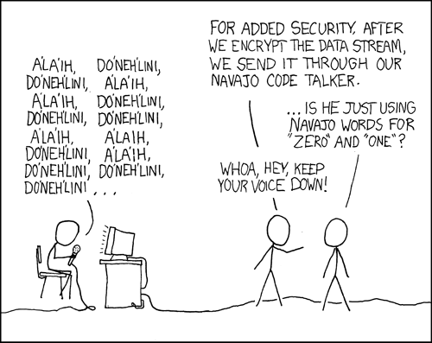
http://xkcd.com/257/

Slide 32
The role of Cryptanalysis in Cryptography
Cryptanalysis plays a very important role in designing cryptosystems
State-of-the-art analysis techniques drive the designs
If an attack exists, a new algorithm should be resilient to it
Determines the security of an algorithm
If an algorithm has a 100-bit key but there is an attack that requires only 2⁴⁰ encryptions, then the algorithm only provides 40 bits of security
Key length determines the work for brute force, but not for smarter attacks

Slide 33
Kerckhoffs’ Principle
A cryptosystem should be secure even if the attacker knows all details about the system, with the exception of the secret key. In particular, the system should be secure when the attacker knows the encryption and decryption algorithms.
It all comes down to the key
Security through obscurity is not a good idea

Slide 34
Security in Cryptography
An algorithm is only as secure as the most advanced cryptanalysis against it
There is no silver bullet, there is no spoon, and there is no one definition of “secure”
In fact, our definition of secure changes every day
A better question might be “What does it take to be considered secure today?”

Slide 35
Key length
We just saw that cryptography provides a map from one set to another
The only way to get the original message back from the ciphertext is to invert the map (go backwards)
This means choosing the right key
For an algorithm to be considered secure, it needs to be computationally infeasible for an adversary to get the key with effort under a threshold
The key needs to come from a large enough key space (set of possible keys)
That threshold keeps rising

Slide 36
Key length and key space
Key length is measured in bits
A key that is n bits long provides a key space of size 2^{n}
Assuming
All keys are possible
No two keys produce the same mapping
How big does n need to be?

Slide 37
Key length then and now
In 1976, DES was the standard algorithm, with a 56-bit key
In 1980, Skipjack had an 80-bit key
TDEA (triple DES) has 112 or 168 bits of key, depending on version
56-bit version for backward compatibility
In 1998, NIST called for a new standard with key sizes 128, 192, and 256
Today, you should have at least 112 bits of security
80 bits is still acceptable, but is being phased out
After 2013, the minimum will be 112
(Note: these sizes are for symmetric algorithms. Asymmetric algorithms, in general, require larger keys)

Slide 38
A game: adversarial indistinguishability
One of the many definitions of security involves a game
Two players
Rules
Player 2 chooses two messages and tells player 1
Player 1 chooses one of the two messages
Encrypts the message
Sends the encrypted message back to player 2
Player 2’s task is to determine whether the encrypted message is an encryption of m₀ or m₁

Slide 39
Adversarial indistinguishability (continued)
1
m₀, m₁
2
Choose i=0
or i=1. Encrypt
m_{i}.
E(m_{i}, key)
Set i’ to
guess
(0 or 1)
i’
i’ = i?
correct/incorrect

Slide 40
Exercise
Pair up and decide who is player 1 and who is player two
Player 1
Come up with a simple deterministic function to encrypt a number from 1 to 100 (remember it needs to be invertible)
For example, f(x) = 2x
You need to be able to compute this in your head!
Player 2
Choose two numbers from 1 to 100 (but not the same one twice!) to use as messages
Play a few rounds
Keep track of when player 2 is right and wrong
player 1 has to use the same function every time
Notes:
This exercise should take about 10 minutes

Slide 41
Exercise (continued)
After a few rounds,
Did you begin to see patterns?
Did you choose numbers (messages) in ways to get new information?
Do you choose them in a way that made you right more often?

Slide 42
Exercise (continued)
If player 2 knows something useful (doesn’t have to be the function, but a hunch) then they will have significantly more right or wrong after many rounds
Can distinguish ciphertext from noise
If player 2 knows nothing, they will have about as many right as wrong after many rounds
No better than flipping a coin
count
Notes:
If more wrong then right, reverse intuition

Slide 43
Section Summary
Cryptology is the study of codes
Cryptography is the study of designing codes
Cryptanalysis is the study of breaking codes
Cryptanalysis plays a key role in algorithm design
Encryption algorithms generally fall into two categories
Symmetric
Asymmetric

Slide 44
Symmetric cryptography
Cryptology
Cryptography
Symmetric
Asymmetric
Cryptanalysis
Protocols
Mathematical
Implementation
Social

Slide 45
Symmetric algorithms
The sending and receiving party use the same key
Alice computes y = Encrypt(x,k)
Alice sends y to Bob
Bob computes x’ = Decrypt(y,k)
The Caesar cipher was an example of symmetric cryptography

Slide 46
Types of symmetric crypto
Symmetric encryption algorithms fall into two categories
Block ciphers
Stream ciphers
Used for different purposes
Both must provide confusion and diffusion

Slide 47
Confusion and Diffusion
Claude Shannon was a famous information theorist
Defined two properties that are widely used in symmetric cryptographic primitives
Confusion
Relationship between key and ciphertext is obscured
Diffusion
The influence of one plaintext symbol is spread over many ciphertext symbols with the goal of hiding statistical properties of the plaintext
Adversary must do more work to find statistical properties
Notes:
Encrypt HELLO and YELLO
Only the first symbol (letter) of the ciphertext changes

Slide 48
Exercise
Form groups of 4-6 people
Each group should
Come up with a one-sentence message
Choose a key in A-Z (0-25)
Encrypt the message with the Caesar cipher
Exchange your ciphertext with another group
Find the message the other group wrote

Slide 49
Another Look at the Caesar Cipher
How does the Caesar cipher stack up in terms of confusion and diffusion?
Confusion
Yes
Diffusion
Changing one symbol in the plaintext has a very predictable result
Only changes one symbol in the output

Slide 50
One-time pad
One-time pad (OTP) is the only cryptosystem that achieves perfect secrecy
Given ciphertext c, plaintext message m
Random variables X and Y (for plaintext and ciphertext, respectively)
Pr[X=m|Y=c] = Pr[X=m]
The a posteriori probability that the plaintext is m is equal to the a priori probability that the plaintext is m
In other words, knowing the ciphertext doesn’t give you any additional insight into the value of the plaintext

Slide 51
One-time pad (continued)
OTP is also unconditionally secure
It cannot be broken even with infinite computational resources
An attacker with infinite resources can break a 10,000-bit key cipher in one time-step
Have 2^{10,000} computers each try a key
That’s more computers than atoms in the universe!
System is computationally secure
Adversary is computationally bounded

Slide 52
One-time pad (continued)
How does this miraculous cryptosystem work?
Plaintext m = x_{o}x₁…x_{n-2}x_{n-1} in binary
Ciphertext c = y_{o}y₁…y_{n-2}y_{n-1} in binary
Key stream K = k_{o}k₁…k_{n-2}k_{n-1} in binary
Random number
source
k_{i}
x_{i}
y_{i}

Slide 53
Why doesn’t everyone use OTP?
The key bits need to be truly random
Does your computer have true random number generator? Mine doesn’t
The sender and receiver must have the same key stream
How do you communicate the key stream securely?
A bit of the key stream can only be used once
Key needs to be as long as the message
That’s a lot of bits over time
A lot to have to send securely
Bottom line: doable, but not practical for the vast majority of applications

Slide 54
The good news
Fortunately, we can approximate a OTP with a stream cipher
Main idea:
Use a shorter key to generate a key stream in a pseudorandom fashion
Practical
Does not achieve perfect secrecy
Can achieve computational security

Slide 55
Stream cipher
Seed (key)
Key stream
generator
k_{i}
x_{i}
y_{i}
Message m = x_{o}x₁…x_{n-2}x_{n-1} in binary
Each x_{i} is combined with a bit of the key stream via exclusive-or (addition modulo 2)

Slide 56
Stream cipher
Decryption is the same as encryption
Swap plaintext and ciphertext
Seed (key)
Key stream
generator
k_{i}
y_{i}
x_{i}

Slide 57
Example
Suppose a stream cipher with the following recurrence:
x_{i+4} = x_{i} + x_{i+1} mod 2
i ≥ 1
Suppose that the initial values are (1,0,0,0)

Slide 58
Example (continued)
10001
x₅ = x₁ + x₂ mod 2
100010
x₆ = x₂ + x₃ mod 2
1000100
x₇ = x₃ + x₄ mod 2
10001001
x₈ = x₄ + x₅ mod 2
100010011
x₉ = x₅ + x₆ mod 2
1000100110
x₁₀ = x₆ + x₇ mod 2
10001001101
x₁₁ = x₇ + x₈ mod 2
100010011010
x₁₂ = x₈ + x₉ mod 2
1000100110101
x₁₃ = x₉ + x₁₀ mod 2
10001001101011
x₁₄ = x₁₀ + x₁₁ mod 2

Slide 59
Example (continued)
So we have a stream that looks like 10001001101011…
Suppose we want to encrypt 10101010
Combine message and key stream with addition modulo 2 (exclusive-or)
Message | 1 | 0 | 1 | 0 | 1 | 0 | 1 | 0
Key stream | 1 | 0 | 0 | 0 | 1 | 0 | 0 | 1
Ciphertext | 0 | 0 | 1 | 0 | 0 | 0 | 1 | 1

Slide 60
Security
That example was not secure, because the key stream was too predictable

Slide 61
Do you have to use xor?
Well… no. But it has nice properties and is most common
Fast
No carries to deal with
Same function for encryption and decryption
Don’t need a separate stream or operation to decrypt
This is perhaps best shown by example

Slide 62
Addition mod m
Instead of using addition mod 2, let’s generalize to addition mod m, m > 2
There will be lg(m)-1 carry values in the computation
Concrete example: m=2⁷
Bitwise operations are convenient because we can skip a register
1 1 1 1 1 0
Carries
1 0 1 1 1 1
+ 1 1 1 1 1 1
1 0 1 1 1 0
Sum

Slide 63
Other benefits of XOR
Decryption performed by inverting combining operation
The inverse operation of addition mod m is subtraction mod m
The inverse operation of multiplication mod m is multiplication mod m, but you would need a different key stream
The inverse operation of XOR is XOR
a XOR b = c
c XOR b = a
Notes:
Multiplication (mod 5): 1 is inverse of 1, 3 is inverse of 2, 2 is inverse of 3, 4 is inverse of 4
Would need inverse key stream to decrypt.
Could also invert addition with addition and different key stream

Slide 64
So how can a stream cipher be secure?
Like the OTP, the security lies in the randomness properties of the key stream
Don’t use the same bits of the key stream more than once, or else
a XOR k = a’
b XOR k = b’
a’ XOR b’ = a XOR k XOR b XOR k = a XOR b
Assume adversary knows a’ and b’
Now a much smaller plaintext space for a and b
Can use heuristics to determine a and b
Gives adversary an advantage

Slide 65
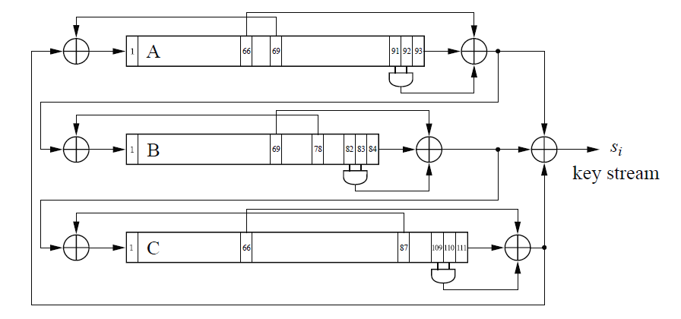
Practical stream ciphers
Large state size, large input key (>112 bits)
Function that updates state is complicated and nonlinear
State outputs few bits at each update (preferably one)
In use
RC4
Snow
Salsa
Trivium

Slide 66
Question
Does anyone happen to know what the US standard stream cipher is?

Slide 67
Answer
That was a trick question
We don’t have one
We might in the not-too-distant future

Slide 68
Why isn’t there a US standard stream cipher?
There hasn’t been an outcry for one
Block ciphers are more studied and better understood
NIST is currently looking into this, but it is a new project

Slide 69
Block ciphers
Main idea: instead of encrypting one bit at a time, encrypt several bits together
The grouping of bits is called a block
Block ciphers play a significant role in many cryptographic systems
Let’s start by considering operations on a single block

Slide 70
Block cipher encryption
Plaintext m = x_{o}x₁…x_{n-2}x_{n-1} in binary
Ciphertext c = y_{o}y₁…y_{n-2}y_{n-1} in binary
Key K
Block size = j
x₀x₁x₂ … x_{j-1}
K
Encrypt
y₀y₁y₂ … y_{j-1}

Slide 71
Block cipher decryption
To decrypt, need to apply (possibly different) decryption algorithm
y₀y₁y₂ … y_{j-1}
K
Decrypt
x₀x₁x₂ … x_{j-1}

Slide 72
Block vs. stream
Constrained devices
Stream cipher
Real-time streaming data
If packets are multiple of block length, block cipher won’t incur too high a penalty
If packet size varies widely, stream cipher may be better bet
Everything else
Block cipher is probably best bet

Slide 73
An essential tool
Block ciphers are not only used for encryption
They are used to construct
Stream ciphers
Pseudorandom number generators
Hash functions
Message authentication codes
Bottom line: block ciphers are an essential tool in symmetric cryptography
We’ll get to these later

Slide 74
More than a block
What happens when you need to encrypt more than one block?

Slide 75
Mode of operation
Block ciphers are used in conjunction with a mode of operation
Mode of operation determines how the blocks connect
Right cipher + wrong mode = wrong solution
We’ll discuss
Electronic Codebook mode (ECB)
Cipher Block Chaining mode (CBC)
Cipher Feedback mode (CFB)
Output Feedback mode (OFB)
Counter mode (CTR)

Slide 76
ECB
The most basic mode
Each block is encrypted independently
Let’s look at the pros and cons
plaintext block 1
plaintext block 2
plaintext block 3
K
Encrypt
K
Encrypt
K
Encrypt
ciphertext block 1
ciphertext block 2
ciphertext block 3

Slide 77
ECB: pros
An error in one block will not affect others
Transmission errors
Missing blocks
Easily parallelizable
Efficient to compute

Slide 78
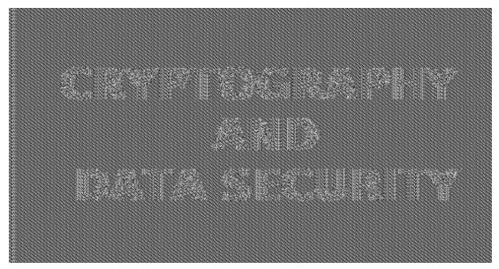

ECB: cons
Leaks information about repeating blocks
Repeating plaintext results in repeated ciphertext
Adversary can rearrange message
“attack don’t stop!” vs. “stop! don’t attack”
Adversary can substitute blocks

Slide 79
ECB example: block substitution
Suppose the following blocks are part of a banking protocol
Sending and receiving banks share a key
Adversary
Opens accounts at each bank
Sends money from one to the other, captures ciphertext
Now can identify transfers between the two banks
When other transfers go between those banks, replaces receiving account # with his
Gets lots of money
Withdraws money and commences with getaway plan
Sending bank | Sending account # | Receiving bank | Receiving account # | Amount $

Slide 80
CBC
Most common
Blocks dependent on previous blocks
Requires an initialization vector (IV)
plaintext block 1
plaintext block 2
plaintext block 3
IV
K
Encrypt
K
Encrypt
K
Encrypt
ciphertext block 1
ciphertext block 2
ciphertext block 3

Slide 81
CBC: decryption
Encryption: XOR then encrypt
Decryption: decrypt then XOR
ciphertext block 1
ciphertext block 2
ciphertext block 3
K
Decrypt
K
Decrypt
K
Decrypt
IV
plaintext block 1
plaintext block 2
plaintext block 3

Slide 82
CBC: a few more words on IV
IV is same size as block
IV is not a secret
Sent in the clear with ciphertext
Necessary for decryption
Think twice about using predictable IV values
Examples
Counters
Repeated values
Using last ciphertext block of previous encrypted packet
Advanced attacks exploit predictability
E.g. BEAST
Use random IV for each encryption
This is important
Random IV is necessary for security properties to hold

Slide 83
CBC: error tolerance
Encryption
Encryption errors propagate forward
Each block uses the result of the previous block
If there was an error in encrypting block 1, that error affects block 2, block 3, and so on
Decryption
Wrong IV in decryption only corrupts first block
Again, don’t consider IV secret
Change to a block of ciphertext corrupts decryption of only two blocks
Adding blocks to the end of ciphertext won’t alter anything before
Probably decrypt to rubbish, but there’s a chance it won’t

Slide 84
CBC: pros & cons
Pros
IV makes encryption probabilistic
Same message-key pair map to different values when IVs are different
More difficult to attack through substitution
Decryption can be parallelized
Cons
Encryption sequential
Cannot be parallelized
Encryption errors propagate
Bit flip early on messes up a lot
Ciphertext stealing may be pro or con
Does not require message expansion (padding)

Slide 85
CFB
Stream cipher–like functionality from a block cipher
IV has to be unpredictable
Decryption is same operation as encryption
IV
K
Encrypt
K
Encrypt
K
Encrypt
plaintext block 1
plaintext block 2
plaintext block 3
ciphertext block 1
ciphertext block 2
ciphertext block 3

Slide 86
OFB
Similar to CFB
Turns block cipher into a stream cipher
IV has to be unique, but not necessarily random
IV
K
Encrypt
K
Encrypt
K
Encrypt
plaintext block 1
plaintext block 2
plaintext block 3
ciphertext block 1
ciphertext block 2
ciphertext block 3

Slide 87
CTR
Different variants
Talk about one in NIST SP 800-38a
Turns block cipher into stream cipher
Counter increases with each block
Does not need to be secret
Needs to be unique across blocks
Counter 1
Counter 2
Counter 3
K
Encrypt
K
Encrypt
K
Encrypt
plaintext block 1
plaintext block 2
plaintext block 3
ciphertext block 1
ciphertext block 2
ciphertext block 3
Notes:
What if adversary can call encrypt w/o knowing key (i.e. on a smartcard)?
- They can generate the key stream and find the plaintext

Slide 88
Choosing a mode
General knowledge
CBC = good, ECB = bad
It isn’t this simple
Everything depends on context
There are more modes to consider
Others we talked about and more that we didn’t
What are your requirements?
Parallelizable? Error tolerant? Synchronizing? Memory, speed, energy requirements? Malleability?
It’s difficult to generalize
What is right for one situation may be wrong for another

Slide 89
Block cipher construction

Slide 90
Common structure
plaintext
Product cipher
Combines two or more transformations
Resulting cipher more secure than components
Round function
Provides confusion and diffusion
Key combined with state (confusion)
Data mixing/permutations (diffusion)
Round 1
Round 2
Round n-1
Round n
ciphertext

Slide 91
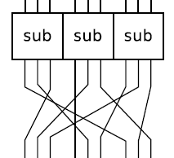
Round structure: SPN
Substitution Permutation Network (SPN)
Substitution box (S-box)
Invertible non-linear function
Often implemented as look-up tables
Permutation
Change bit locations

Slide 92
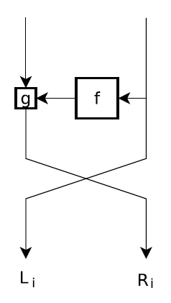
Round structure: Feistel
Split state into left and right
Encrypt and decrypt functions use same logic
Smaller footprint
f contains a non-linear function
S-boxes do not need to be invertible in Feistel ciphers
g is operation to combine the left and right
Example: xor

Slide 93
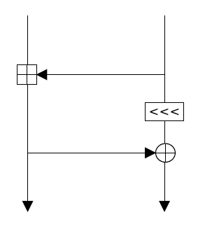
ARX
Addition-Rotation-XOR
Two kinds of linear operations
Translating them into a single linear form is difficult over many rounds
Acts as simple substitution box
No need for tables
Easy to compute

Slide 94
More rounds = more security, right?
Not exactly
While this seems intuitive, there is a caveat
Rounds cannot be exactly identical
Tools for this
Key schedule
Round constants
Notes:
Show slide attack on board

Slide 95
Concrete example: AES
Let’s look at the round components of a real cipher
Round consists of nonlinear step and linear mixing
Which provides confusion, and which provide diffusion?
Round structure
SubBytes
nonlinearity
ShiftRows, MixColumn
Linear mixing
AddKey
Combine key with state via exclusive-or

Slide 96
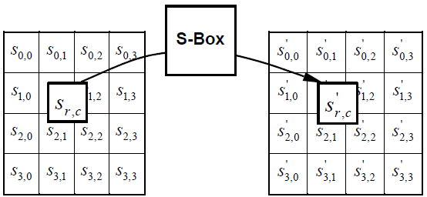
AES: SubBytes
Byte substitution
Replace a byte of data with another according to a function
The function is invertible so that we can reverse the substitution
S’_{r,c} = S-Box(S_{r,c})

Slide 97
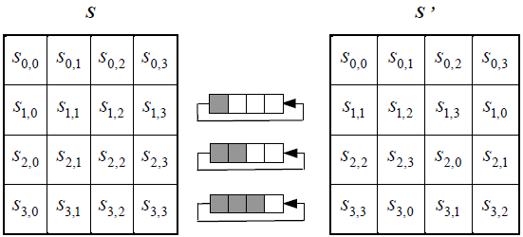
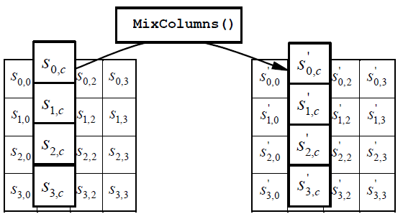
AES: ShiftRows and MixColumns
ShiftRows
Circular shift on each row of the state
Shift amount differs by row
MixColumns
Multiply each column of the state by a fixed matrix
S’_{*,c} = S_{*,c} · matrix

Slide 98
Asymmetric Cryptography
Cryptology
Cryptography
Symmetric
Asymmetric
Cryptanalysis
Protocols
Mathematical
Implementation
Social

Slide 99
Asymmetric Crypto
Asymmetric cryptography = public key cryptography
Different key used by different parties
Key use is not symmetric
Mailbox analogy
There is a locked mailbox with a slot
Anyone can put a message in the box
Only a person with the mailbox key can retrieve the messages

Slide 100
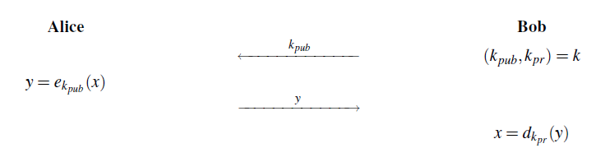
The Basic Picture
Bob gives Alice his public key, k_{pub}
Alice can send Bob x, encrypted with Bob’s public key
Only a person who knows Bob’s private key can decrypt it and get x

Slide 101
Principles of asymmetric ciphers
Based on hard problems
Not confusion and diffusion
As long as there is no polynomial-time algorithm to solve underlying problem, algorithm secure
*with reasonable key length

Slide 102
Factoring
Given an integer n, find the prime factorization
42 = 2 * 21 = 2 * 3 * 7
Now do it for a 2048-bit integer
Yea… it is tough
Trapdoor function that requires knowledge of factorization
Primes are part of the private key
Adversary only gets the product
Has a lot of work ahead

Slide 103
Factoring: RSA
N=p*q, p and q are primes
Encryption: x^{e} mod N
Decryption: x^{d} mod N
RSA public key has (e, N)
Decryption exponent d derived from e, p and q

Slide 104
Discrete logarithm
Given xª = y and x, what is a?
There are conditions
Only certain set/operation combinations can be used for crypto
x must be a generator (x has to create all elements of set when you keep multiplying it by itself)

Slide 105
Post-quantum
Solve factoring and you also solve discrete log
Shor’s algorithm does just that
The catch is that you need a quantum computer to run it
Research in post-quantum asymmetric algorithms
Multivariate public key
The coefficients of polynomials are polynomials
Lattice-based cryptography
Code-based cryptography
Error-correcting codes

Slide 106
Symmetric Vs. Asymmetric
Symmetric | Asymmetric
Same key for encryption and decryption | Different keys for encryption and decryption
Based on confusion and diffusion | Based on number theoretic problems
Repeated iterations of simple function | Can be expressed as simple equation

Slide 107
When should I use what?
Symmetric algorithms
More computationally efficient
Key distribution is a problem
Asymmetric algorithms
More computationally expensive
Do not need to agree upon a key
Need to establish authenticity of public key
Symmetric better for sending data
Asymmetric better for sending symmetric keys
Wrap symmetric key

Slide 108
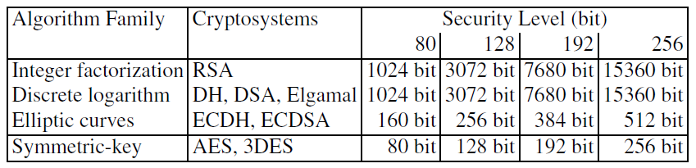
Key length
Key lengths for asymmetric algorithms are different from symmetric
In general, it takes a longer key to have the same protection against brute force attacks
Note: This is no longer sufficient

Slide 109
Key length (continued)
Why do you think that asymmetric algorithms require longer keys?
Notes:
For n-bit key, all 2^{n} keys not equally likely.
Not every x in 2^{n} is a possible key (because of structure)
Factoring problems require primes
Composites not candidates

Slide 110
More primitives
Cryptology
Cryptography
Symmetric
Asymmetric
Cryptanalysis
Protocols
Mathematical
Implementation
Social
Now that we’ve looked at symmetric and asymmetric topics, we’ll dive a little further into both areas

Slide 111
Hash functions
Do not encrypt/decrypt
Do not provide confidentiality
Do fall under symmetric cryptography
Constructed with symmetric primitives
Provide means of integrity checking

Slide 112
What is a hash function?
Function that maps arbitrary-length input to fixed size output
Output space is smaller
Multiple inputs map to same output

Slide 113
Cryptographic hash functions
When we say “hash functions”, we often mean “cryptographic hash functions”
Create a “digital fingerprint” of data
Three properties
Collision resistance (strong collision resistance)
Preimage resistance
Second preimage resistance (weak collision resistance)
There are variants for each of these, but only main concept covered here

Slide 114
Collision resistance
Infeasible to find x ≠ y such that h(x) = h(y)
Resistance is upper-bounded by the birthday problem

Slide 115
Birthday problem
Deals with probability that two people have the same birthday
We have n people in this room
There are 365 days in a year
366 if February 29 included
Probability of two of the same birthday is about 0.5 when n=23

Slide 116
Birthday problem (continued)
Assume only 365 days
Start with two people
Pr(2 people no same birthday) = 1 – 1/365
Add a third person
Pr(3 people no same birthday) = (1 – 1/365)(1 - 2/365)
Add t more people
Pr(n people no same birthday) =
(1 – 1/365)(1 - 2/365)…(1 – (n-1)/365)

Slide 117
Birthday problem (continued)
Pr(at least one collision) = 1 – Pr(no collision)
1 - (1 – 1/365)(1 - 2/365)…(1 – (n-1)/365)
Let n=23
1 - (1 – 1/365)(1 - 2/365)…(1 – (23-1)/365) = 0.507 ≈ 0.5
Let’s try it with this group
When can we guarantee a collision?
Pr(collision) = 1

Slide 118
Pigeon hole principle
If n pigeons are put in m pigeon holes, n > m, then at least one hole contains more than one pigeon
Note that some holes may be empty

Slide 119
Pigeon hole and collisions
If the output space size is m, then m+1 inputs needed to guarantee a collision
Assuming 365 days, need 366 people to guarantee at least two share a birthday
Need 367 people if assuming 366 days
For hash function with n-bit output (m=2^{n}), then 2^{n}+1 message blocks needed for collision

Slide 120
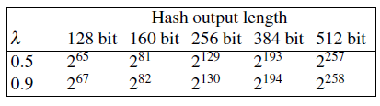
Birthday bound
Output should be too large for m+1 blocks to be feasible
Birthday attack (based on birthday problem) bigger concern
Generic attack that works on any hash function
Not guaranteed to be best attack on any specific hash function
Provides the birthday bound
Recall that 80-bits is ok for now, but moving towards 112

Slide 121
Random oracle model
Captures the “ideal” hash function
Give the oracle x
Oracle responds with a seemingly random value
Always responds in the same way for the same input
Think of as looking up h(x) in a massive book of truly random numbers
There is no such thing as a true random oracle
But we want our hash functions to act like one

Slide 122
Random oracle model (continued)
We were thinking in this model just now
“All birthdays not equally likely”
Probably true, but when we think in the ROM, they are
Pr[h(x) = y] = 1/M
Where M is the size of the output
Knowing h(x) should give no insight about the result of any other value
Must query oracle to find h(x’)

Slide 123
Random oracle model (continued)
If a hash function can be reliably distinguished from a random oracle, then there is trouble
In the ROM, interesting things can be proven
Collision resistance implies preimage resistance

Slide 124
Exercise: random oracle
Break into pairs
Decide who will be player 1 and who will be player 2
Player 1 acts as oracle
Come up with a simple hash function (not cryptographic) on integers
Example: h(x) = 2x+3 mod 5
Make sure you have a modular operation to keep the output size fixed
Don’t tell player 2 your function
Player 2
Query the oracle with integers
Given the result of several queries, try to guess the results for other values you haven’t queried with yet
Tell player 1, and they will tell you if you are right or wrong
Keep track of right and wrong
Switch roles

Slide 125
Exercise: random oracle (continued)
It is helpful to make a table to capture what you’ve learned so far
Based on this table, what do you think h(20) is?
x | h(x)
0 | 0
1 | 1
50 | 0
10 | 0
15 | 1
Notes:
The function here was h(x) = x mod 2

Slide 126
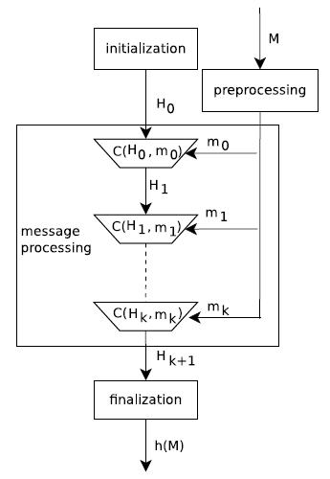
Iterated hash construction
Fixed-size blocks as input
Compression function acts as a random mapping
Ingests a block of the message
Notes:
A lot like block cipher, but blocks combined
Dough analogy
Flatten dough (add a block)
Fold dough (compression function)

Slide 127
Preimage resistance
Given z, infeasible to find x such that h(x) = z
Infeasible to find a value that maps to h(x)
image
preimage
Notes:
f(x)=y : y is image of x under f
f⁻¹(y)=x : x is preimage of y under f (all x that map to y)

Slide 128
Second preimage resistance
Given x, infeasible to find y ≠ x such that h(x) = h(y)
Infeasible to find second value that maps to h(x)
image
preimage

Slide 129
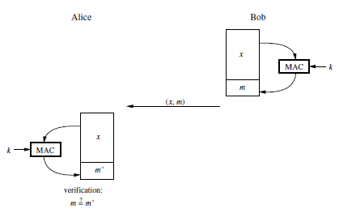
Message authentication codes
Authentication
Someone who knows the key created this MAC
Integrity
If the message is altered, the MAC will not match

Slide 130
MAC integrity
Integrity + authentication
Can detect accidental or nefarious modifications
Can have variable length MAC
Fixed length MAC nicer
Sign a hash
Hash function provides additional integrity check

Slide 131
Who created the message?
Alice, Bob, and Charlie share a key
Message: “Charlie is stupid”
Charlie is upset and wants to know who wrote it
Alice says Bob did
Bob says Alice did
Because they both know the key, it could have been either of them
No definitive proof which one created it
It may have even been Charlie, as far as Alice and Bob are concerned

Slide 132
Digital signatures
In the real world, contracts are finalized with signatures
Signing indicates that you agree to terms
Signature assumed to be unique to individual
Legal and social barriers to prevent forgeries
Only the person who knows a key can generate a valid signature
Only one person knows that key (supposedly)
Authenticates signer

Slide 133
Digital signatures (continued)
Uses asymmetric encryption and hash functions
Sign with private key
Anyone can verify signature using public key
But asymmetric operations expensive
What if message is longer than allowed?

Slide 134
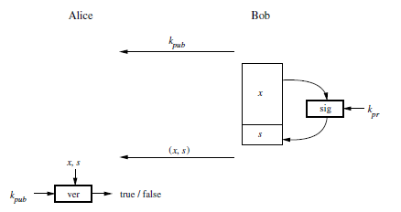
How RSA digital signatures work
Bob hashes plaintext message
Make fixed size input
Sign (encrypt) hash with his private key
Alice decrypts signature with Bob’s public key
Hashes message
Verifies that the two match

Slide 135
Nonrepudiation and confidentiality
Nonrepudiation
Bob can’t deny creating the signature
If confidentiality needed on message
Sign, then encrypt message (or message + signature)
Why not sign the encrypted data?
May inadvertently sign wrong info
Allows bait and switch by party sharing symmetric key
Would you sign an envelope containing a contract, hoping the contract is the one you think it is?
Signing message then encrypting both is analogous to signing a contract, then putting it in an envelope

Slide 136
Signatures and encryption
Sign and encrypt message
Sign and encrypt message + signature
Why might one be better than the other?

Slide 137
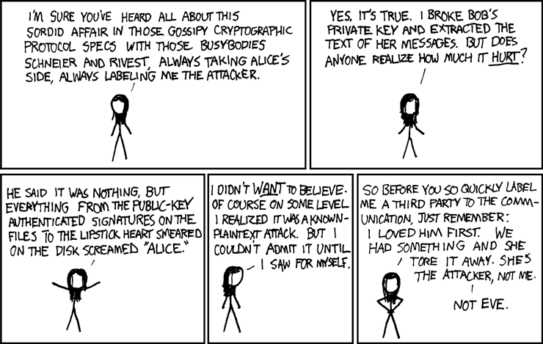
http://xkcd.com/177/

Slide 138
Protocols
Cryptology
Cryptography
Symmetric
Asymmetric
Cryptanalysis
Protocols
Mathematical
Implementation
Social

Slide 139
Kinds of crypto protocols
There are lots of crypto protocols
Key distribution
Multiparty computation
Zero-knowledge
Voting
And many more
We’ll focus on the most common: key distribution

Slide 140
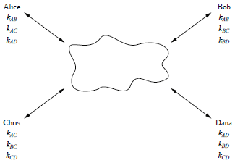
Key distribution problem
Assume every user in a network must share a symmetric key with every other user
N users means on the order of N² keys
Imagine that this network is the Internet
Management nightmare

Slide 141
Key Agreement
Key agreement is a very important concept in using cryptography
Security of communications relies on secrecy of key
How can parties exchange keys without compromising the key?
Parties create key together
One party creates key and sends to the other
Key derived by trusted third party and sent to both

Slide 142
Key distribution center
Can use symmetric keys to create a session key
Requires a trusted third party, KDC
Alice and KDC share a key encrypting key (KEK)
Same for Bob
Alice establishes key with Bob
Requests a key from KDC
KDC generates a short-term key
Distributes key to Alice and Bob, encrypted by respective KEKs
Alice and Bob now share a key

Slide 143
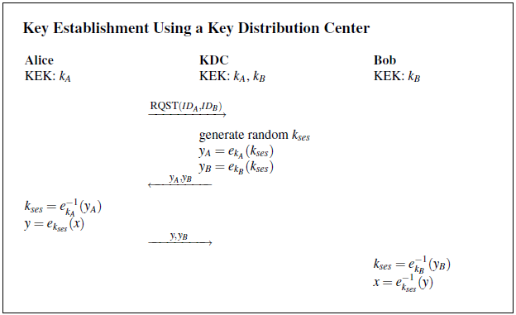
KDC example
Notes:
This image from the text does not show Bob receiving y and y_B, but he does

Slide 144
KDC pros and cons
Pros
KDC stores N KEKs
Each user only needs KEK
Key establishment once for each new user
This secure channel outside scope of discussion
Cons
If KEK compromised, adversary can masquerade as Alice
Replay
Adversary can impersonate KDC and send Alice and Bob old keys
No way to ensure freshness
Trusts that session key is with Bob, but may not be able to verify
Adversary can change request
Single point of failure
KDC compromise brings system to a halt

Slide 145
Kerberos
Well-known KDC protocol
Time matters
Session keys have lifetime
Lifetime encrypted
Prevents replay
Challenge to KDC
Alice knows she’s talking to KDC, not adversary

Slide 146
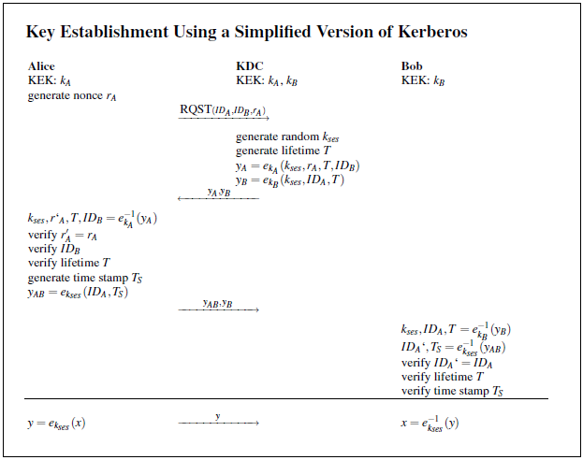
Simplified Kerberos

Slide 147
Cons
Fixed some of the cons of first KDC protocol
Remaining
Single point of failure
Lack of forward secrecy
If adversary compromises session key, all communications under that key are at risk
Only for duration of key lifetime
Setting up KEK for new user

Slide 148
Key establishment models

Slide 149
Point-to-point centralized
One party gives the key to the other party
Direct communication
Alice
K
Bob

Slide 150
Centralized key management
A single party generates and manages keys
May distribute to both parties
One party may be responsible for passing it on
Each party shares a distinct key with the KDC, but not each other
Centralized key generation
KDC
KDC
K
K
K
K
Alice
Bob
Alice
Bob

Slide 151
Key translation center
Like centralized key management, but key generated by a party
Distributed key generation
KTC
K
K
Alice
Bob

Slide 152
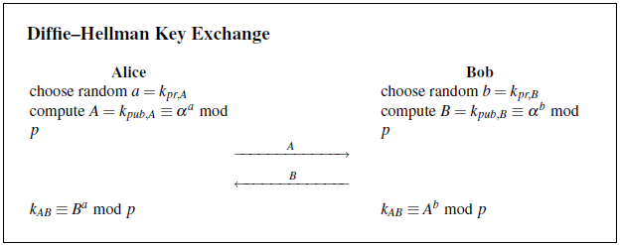
Diffie-Hellman key agreement
Asymmetric method
Both parties agree on parameters α and p
Each party chooses a secret exponent

Slide 153
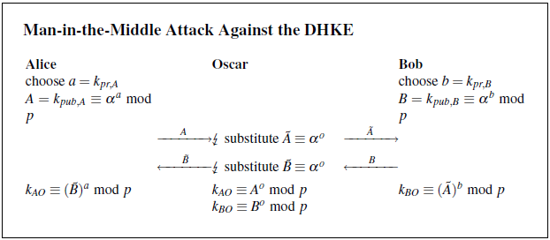
DH pros and cons
Pros
Does not require a trusted third party
Does not require any other keys
Cons
Does not authenticate either party (may not be a con)
Allows man-in-the-middle (MITM) attack

Slide 154
Certificates
Provide binding between public key and party
Public key bound to Alice
Public key bound to Bob
Alice and Bob can verify that they are talking to each other, not someone in the middle
Generated by certificate authority (CA)
Trusted third party

Slide 155
Key transport with CAs
Trusted authority issues certificates
Signed by trusted authority
Key exchange with certificates
Alice gets Bob’s certificate from Bob
Verify that Bob’s certificate is valid using CA public key
Create session key
Encrypt session key with Bob’s public key (in certificate)
Send to Bob
Bob decrypts with private key
Session key established

Slide 156
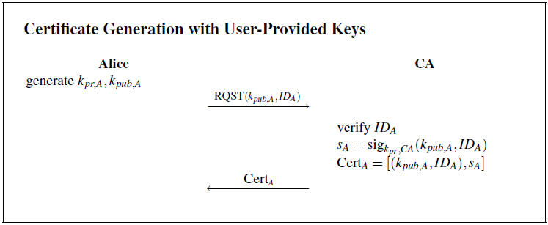
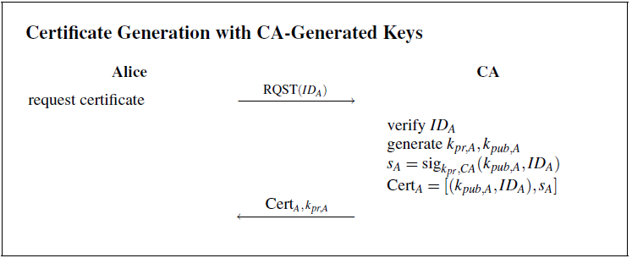
Obtaining keys

Slide 157
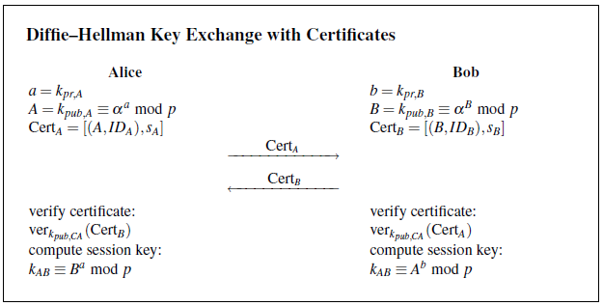
DH with certificates
Certificates for authentication
Requires trusted certificate authority
Typo in book: should be α^{b}
Notes:
Typo in this image. On the right, should be B=K_{pub,B} = alpha^{b} mod p
(wrong case of b in image)

Slide 158
CAs and PKI
Public-key infrastructure (PKI)
CAs + support
Key storage, distribution, etc.
CA1 signs CA2, CA2 signs CA1
Parties with CA1 certificates can now talk to parties with CA2 certificates
Ability to revoke certificates
Certificate Revocation List (CRL)
Blacklist
Alice checks CRL to verify that Bob’s certificate is not on the list
If it is on the list, reject it

Slide 159
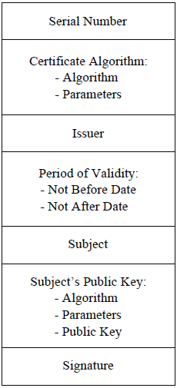
X.509
Minimum certificate contains key and identity
X.509 contains a lot more
In IE, go to Tools > Internet Options > Content > Certificates
Browse certificates
Go to your favorite login page (e.g. gmail)
Right-click on the page
Properties > certificates

Slide 160
Exercise: certificates and RSA
Most (if not all) the certificates just seen were RSA
What might an RSA key exchange with certificates look like?
Notes:
Server authentication, client-server authentication

Slide 161
CA trust models

Slide 162
Trust with separate domains
Two CA’s have no trust relationship
Each CA is part of its own domain
Users in one domain unable to verify authenticity of certificates originating from other domain
CA 1
CA 2
User1₁
User1₂
User2₁
User2₂
Notes:
HAC 13.6.2

Slide 163
Strict hierarchical trust model
Interoperability between domains
Rooted tree
Verify certificates all the way up to the root
CA 3
CA 1
CA 2
User1₁
User1₂
User2₁
User2₂

Slide 164
Multiple rooted tree
Cross-certificate between two CAs
Certificate for X signed by Y
Certificate for Y signed by X
CA 3
CA 6
CA 1
CA 2
CA 4
CA 5
User1₁
User1₂
User2₁
User2₂
User4₁
User4₂
User4₁
User4₂

Slide 165
Reverse certificates
CAs lower in the hierarchy also sign for CAs that are higher
Forward certificate
Child certificate signed by immediate parent
Reverse certificate
Parent certificate signed by immediate child
CA 3
CA 1
CA 2
User1₁
User1₂
User2₁
User2₂

Slide 166
Reverse certificates (continued)
Verification different than strict hierarchical model
Start with public key of CA that created certificate
Find least common ancestor
Do not need to go up to the root

Slide 167
Directed graph trust model
Distributed trust model
Web of Trust
No root or tree mandated
An CA may cross-certify any other
Each user entity start with its local CA
CA 3
CA 1
CA 2
CA 4
CA 5
CA 6

Slide 168
Food for thought
Symmetric exchange
Keys have lifetime
Limit damage by adversary
Asymmetric
CA revokes compromised certificates
If you use biometric data as keys, what happens if you’re compromised?
Gummy bears foil fingerprint readers
http://www.schneier.com/crypto-gram-0205.html#5
I’d like a new set of fingerprints, please

Slide 169
Cryptanalysis
Cryptology
Cryptography
Symmetric
Asymmetric
Cryptanalysis
Protocols
Mathematical
Implementation
Social

Slide 170
Adversaries
There are two kinds of adversaries to consider
Computationally unbounded
There is no limit to their computing power
Only OTP can beat them
Computationally bounded
Real world

Slide 171
Asking the Right Questions
People sometimes ask me for crypto help
Question: How do I break <insert current strong algorithm here>?
My answer: wait 10 years
Surprisingly, people don’t like this
Ok, I only give these kinds of answers to people I know pretty well
The reason I say this is because that is what they asked
But it is not what they meant

Slide 172
Attack models
The adversary (who is sometimes you!) doesn’t always have access to the same information
Different levels of access enable different types of attacks
Each of these levels of access is captured by a model
Knowing what model you’re working with will help you assess your options

Slide 173
Brute force
The most naïve approach
Will always work
Should take a long, long time
The message should no longer be sensitive by the time the attack succeeds

Slide 174
Ciphertext-only
Goal: find key or plaintext
Access to a set ciphertexts
This applies whenever access to encrypted data is available
Confiscated computer with FDE
Capturing encrypted network traffic

Slide 175
Known plaintext
Goal: find key
Access to a set of plaintext-ciphertext pairs, created with the same encryption key
This applies when there is knowledge of the plaintext the corresponds to captured ciphertext
Bad implementation leaves plaintext data structure
Data structure or packet payload always the same
Obtained plaintext through another channel

Slide 176
Chosen ciphertext
Goal: find key or plaintext
Access to decryption function, possibly resulting plaintexts
If errors occur, such as incorrect plaintext format, plaintexts may not be released to adversary
Attack may be adaptive
Create ciphertext based on what you’ve learned
Applicable when decryption requests can be made
Trusted computing
Anything that doesn’t ask for the key for decryption

Slide 177
Chosen plaintext
Goal: find key
Access to encryption function and resulting ciphertexts
May be adaptive
Applicable when encryption key not in adversary’s control
Service offered by entity or device
Smart cards
Crypto chips

Slide 178
Other information
Access to implementation
Binary data
Hardware module
May be able to get data from the implementation without going after the crypto itself

Slide 179
Good bets
Physical access to computation
Implementation attack
Access to encryption procedure
Chosen plaintext
Access to decryption procedure
Chosen ciphertext
Interception only
Ciphertext only
Known plaintext
Get the info from the binary or device
Notes:
Physical access to computations allows bypass of many protective mechanisms.
Protocols give a lot of options.
More information gives the adversary greater abilities

Slide 180
And more
Sometimes there is more info to leverage
Use in conjunction with one of these models
Example
Related-key
Known-plaintext
Chosen ciphertext
Use multiple keys instead of single key
Know something about the relationship between them
Notes:
If two keys share half their bits, can use collected data from both keys to find shared portion

Slide 181
Mathematical (analytical) attacks
Cryptology
Cryptography
Symmetric
Asymmetric
Cryptanalysis
Protocols
Mathematical
Implementation
Social

Slide 182
Of more theoretical interest
There are several analytical attacks out there
Lots of beautiful math
Symmetric cornerstones
Linear cryptanalysis
Differential cryptanalysis
Asymmetric
Factoring
Discrete log
Tricks when bad parameters used to make key

Slide 183
General principles for analytic attacks
Reduce your work
Isolate parts of the state/key as much as possible
2^{n/3} + 2^{n/3} + 2^{n/3} is a lot smaller than 2^{n}
Example: n=9
8+8+8 = 24 vs. 512
This is why diffusion is important
Prevents adversary from isolating sections

Slide 184
Symmetric analytical attacks in brief
Linear cryptanalysis
Find linear relationships between plaintext, ciphertext, and key
Allows adversary to find parity of the key
Reduces key space search considerably
Differential cryptanalysis
Known difference between plaintexts results in certain ciphertext difference with some probability
Difference could be introduced into ciphertext instead of plaintext
Difference could be in related keys

Slide 185
Linear vs. differential
Which one requires a stronger adversary?
What models might each use?

Slide 186
Factoring
Suppose you don’t have a quantum computer
You can factor 512-bits on your own with publicly available tools
Msieve, GGNFS
Currently, record is 768-bit integer
Took 3+ years by experts
General number field sieve (GNFS)
Relies on heuristics and a lot of memory and computing power

Slide 187
Discrete log
Here’s a high level view of two methods
Index calculus method
Probabilistic algorithm
Linear algebra
Group theory
Pollard’s rho algorithm
Generator generates all values of the finite set
There must be a cycle
Find a cycle
x_{i} congruent x_{2i} modulo m
Gives equation that can be used solve discrete log directly
Has analog for factoring

Slide 188
Implementation attacks
Cryptology
Cryptography
Symmetric
Asymmetric
Cryptanalysis
Protocols
Mathematical
Implementation
Social

Slide 189
Implementation Matters
A mathematical specification is one thing, but an implementation is a whole new beast
Implementations leak information
Vulnerable to side channel cryptanalysis
Examples
Time to compute
Different inputs to an operation may cause subtle timing differences
Older OpenSSL implementation was subject to this
Cache attacks on AES cloud computing environment

Slide 190
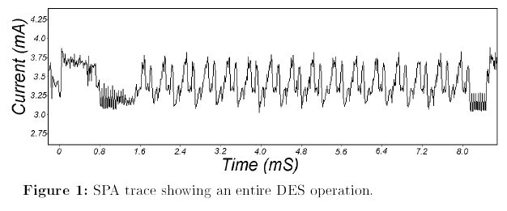
Power and EM attacks
Different operations take different amounts of power
Simple power analysis (SPA)
Differential power analysis (DPA)
Operations alter electromagnetic field differently
Image from “Differential Power Analysis” by Kocher et al.

Slide 191
Power and EM fields (continued)
Can perform adaptive chosen ciphertext attacks to obtain plaintext and key, a small amount at a time
Can perform adaptive chosen plaintext to find key
Notes:
Linear search for key possible

Slide 192
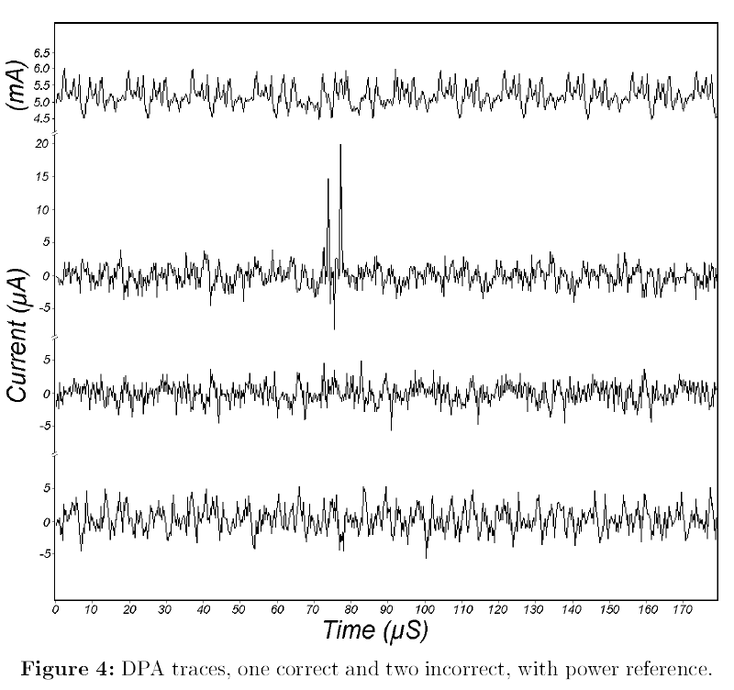
Power and EM: an example
Suppose guessing bit correctly makes a spike in a particular location
Start with key all zeros, key is n bits
For i=0 to n-1
Decrypt or encrypt with
k[i]=1
k[i]=0
Keep the value that causes a bigger spike
O(n) encryption/decryption
Notes:
Image from “Differential Power Analysis” by Kocher et al.

Slide 193
Grabbing the key
The key has to be exposed somewhere
Software implementation
In memory
Hardware
In flash memory or hard coded
Physically extracting key from hardware is tricky
Need to shave off chip to get at gates or memory
May destroy chip
May accidentally destroy key

Slide 194
Example: square-and-multiply side channel
An efficient way of computing x^{e} mod n is using an algorithm called square-and-multiply
Starts with a=1
Work from most significant bit of e down
If current key bit is 1, multiply follows square (SM)
a=a²
a=ax
If current key bit is 0, square alone (S)
a=a²
What is the value of e based on this string?
SSSSMSMSMSMSSSM
0
0
0
1
1
1
1
0
0
1

Slide 195
Exercise: securely computing square-and-multiply
Break into groups and answer the following
What is it that makes the attack on the previous slide possible?
How can you prevent this attack on square-and-multiply?

Slide 196
Demo
What do square and multiply operations look like?
JCrypTool demo

Slide 197
Attacks: further reading
“Remote timing attacks are practical” by Boneh and Brumley
“Differential Power Analysis” by Kocher et al.

Slide 198
Social Attacks
Cryptology
Cryptography
Symmetric
Asymmetric
Cryptanalysis
Protocols
Mathematical
Implementation
Social

Slide 199
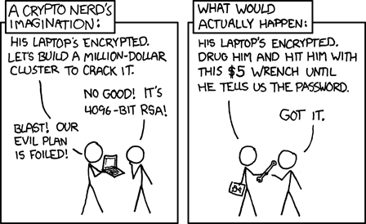
http://xkcd.com/538/
Notes:
The left is hard and expensive. The right is easy and cheap.

Slide 200
Social attacks
Attacking the crypto is usually pretty hard and requires skill (unless an attack has been included in a tool)
Why not just go around the crypto?
Humans are generally the weakest link in a system
People can be coerced
Someone holds a gun to your head and says “your secret key or your life”
What would you do?
What if they threatened someone you love?
Espionage
Blackmail
Bribery

Slide 201
Phishing and impersonation
Your account has been suspended due to suspicious activity. Please follow the link and enter your username and password to verify your identity and reactivate your account.
Completely bypasses the cryptography

Slide 202
Policy attacks
In addition to social attacks on people, can attack policies
Policies force certain behavior
Passwords
Common to derive secret key from password
Backward compatibility
Policy knowledge can give the adversary an advantage
Password rules
Force use of deprecated cipher

Slide 203
The human brain & passwords
People can remember 5-9 chunks of information
Unfamiliar things make smaller chunks
E.g. “Rks9%3”
Each character a chunk
Familiar things enable larger chunks
E.g. “four score and seven years ago”
The entire phrase one chunk (or 6 chunks)
“four” comes from a much larger set than “R”
Words in phrase related, so phrase not high entropy
“four pig ninja gumby minitrue fire” less predictable
Notes:
If key generated from password, lack of entropy in the password results in lack of entropy in the key.
This gives the adversary an advantage.
Dictionary attack.

Slide 204
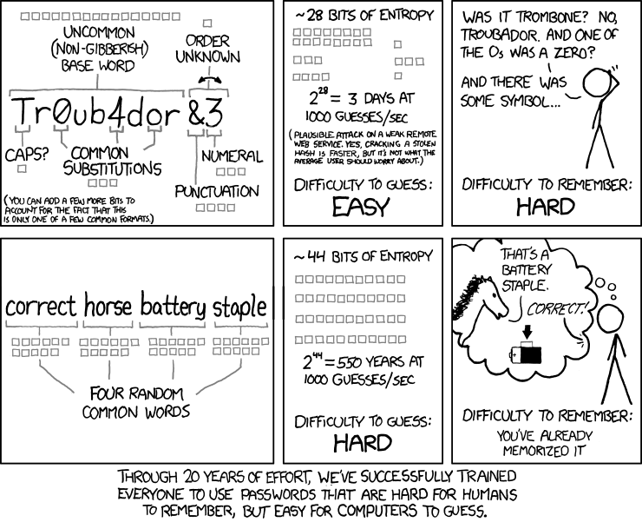
Password rules
http://xkcd.com/936/

Slide 205
Exercise: identifying attack vectors
Imagine a protocol where a button is pressed on a remote, and a light turns on or off
Remote is physical device, i.e. dongle
The transmitter and receiver each have a shared fixed value, v, and a counter, ctr
Counters increment and are synched
Transmitter and receiver share a symmetric key, K
Transmitter sends encrypted message E(v||ctr, K) to receiver
Receiver decrypts message
If v is correct and ctr is in acceptable range, turn on/off light and increment counter
Else, do nothing

Slide 206
Exercise: identifying attack vectors (continued)
Your goal: turn the light on/off
What are possible attack vectors?

Slide 207
How to attack a protocol

Slide 208
Man-in-the-middle
Saw this with Diffie-Hellman
Convince A and B that they are talking to each other
In reality,
A is talking to E (who claims to be B)
B is talking to E (who claims to be A)
E is transparent to both A and B

Slide 209
Reflection
Suppose A and B share a key, k
Suppose they authenticate each other with the following protocol
A
r_{A}
B
E_{k}(r_{A},r_{B})
r_{B}

Slide 210
Reflection (continued)
E can impersonate B by reflecting messages back to A
Two protocols running at once
Intercept messages
A believes it has authenticated B, but B was not involved at all
A
r_{A}
E
r_{A}
E_{k}(r_{A},r’_{A})
E_{k}(r_{A}, r_{B} = r’_{A})
r_{B}

Slide 211
Mitigating reflection
Different keys for different communication directions
Include identifier of originating party in messages
If A gets an encrypted message from A, then reflection can be detected

Slide 212
Interleaving attack
Assume all public keys authentic
A and B choose random values and sign them
A
r_{A}
B
r_{B},s_{B} (r_{B},r_{A},A)
r’_{A},s_{A} (r’_{A},r_{B},B)

Slide 213
Interleaving attack (continued)
Authenticate with B as A
E initiates with B as A
E initiates as A with B
Use messages from one exchange to finish the other
A
E
r_{A}
B
r_{B},s_{B} (r_{B},r_{A},A)
r_{B}
r’_{A},s_{A} (r’_{A},r_{B},B)
r’_{A},s_{A} (r’_{A},r_{B},B)

Slide 214
Misplaced trust
A trusted third party is inherently trusted
What could happen if the TTP is not trustworthy?
Notes:
Examples:
TTP doesn’t check authentication (Alice thinks she’s talking to Bob, but TTP never verified Bob)
TTP leaks your info and voids security

Slide 215
When is an algorithm broken?

Slide 216
Is it broken?
Think of your data (plaintext or keys) as delicious candy and an encryption algorithm as a piñata
That makes cryptanalysts kids with bats
They keep hitting the piñata, making dents
Eventually a seam splits
Then it cracks open and the candy falls out
It is clearly broken at this point
The dents don’t mean its broken, but they start to add up
You may even be able to get a couple pieces of candy out of a split seam
Notes:
Imprecise analogy

Slide 217
Is it broken? (continued)
Attacks accumulate
An “academic” attack hits the scene
Improved over many iterations
Eventually becomes practical
If best practical attack has complexity below security threshold, the algorithm is broken
If there’s not much left, it is close enough and you should already be transitioning
If a property you were counting on is compromised, transition now
Example: new attack on AES shaves off almost 2 bits
Even with that, 126 > 112, so it is ok for now

Slide 218
Maybe its broken, maybe its not
All algorithms will eventually be broken
It is a matter of when
You should start to worry when the attacks look like they might become practical soon
Example: SHA1
2004: Attacks in SHA-0
Plans to attack SHA-1
2005: Attack on SHA-1
Collisions, not preimages
Not recommended in new applications
Ok in legacy applications, where collision less important
Today: SHA-1 still in use (have > 2⁵⁰ complexity for collision)
SHA-2 family preferred
SHA-3 standard in progress
Notes:
More attacks than discussed here.
In NSRL, only preimage attacks relevant, so collision attacks on hash functions it uses don’t change security

Slide 219
It will all break eventually
There is often a significant cost to changing algorithms
Especially in hardware
Backward compatibility is always an issue
Cryptology is dynamic, not static
Attacks take a long time to mature, but break could be tomorrow
When algorithm crippled, need to act quickly
Plan for change in any design

Slide 220
Case Studies
When good crypto goes bad

Slide 221
Important
There is crypto, and there’s the system it is part of
As soon as you look at crypto as part of a system rather than a stand-alone object, things change
You need to be mindful of the attack vectors that you introduce

Slide 222
WEP
Wired Equivalent Privacy
Secure wireless network communications
WEP is a good example of doing it wrong
But why?

Slide 223
WEP (continued)
Uses RC4 stream cipher
Seed has two parts
IV: 24 bits (public)
Key: 40 bits (secret)
CRC32 for integrity
Let’s take a look at each of these

Slide 224
WEP: key and IV
Export restrictions limited key size
64-bit WEP is 40-bit secret plus 24-bit IV
There is a 128-bit version
104-bit secret plus 24-bit IV
Cipher key = IV||secret
First rule of stream ciphers
Don’t reuse the same key stream
2²⁴ is not large
Especially on a high-volume network
Small IV space causes high probability of using same key stream more than once
BAD!

Slide 225
WEP: RC4
Bias in key stream
Bytes do not occur with equal probability
First couple bytes have strong bias
For each packet, you’re at the beginning of the key stream
Bias in every packet
Attacker can collect several messages
Already knows IVs
Can get info on XOR of two messages
The secret is revealed with an obtainable amount of data and some analysis
Note this is all possible from nothing but ciphertexts

Slide 226
WEP: integrity check
CRC32
Cyclic redundancy check, 32-bits
Linear and predictable
Good for detecting random transmission errors
Not cryptographically secure
Adversary can make changes such that CRC32(modified) = CRC32(original)
i.e. bit flipping
Terrible integrity check
It wasn’t designed for this purpose

Slide 227
WEP is good for something
In all fairness, all ciphers broken eventually
WEP fails even if RC4 still worked well
It is important because it does contribute to our knowledge of what not to do
It also gives support to an attack model
Related-key attack model
Some people say that it is unrealistic
People who defend it just need to point to WEP

Slide 228
EMV Payment
“Chip and PIN is Broken” by Murdoch et al.
Europay, MasterCard, Visa
Prominent payment protocol
Known as “chip and PIN”
Payer uses smartcard and PIN
Goal: minimize cost of disputes from issuing bank

Slide 229
EMV Payment (continued)
Two places for burden
Payer used chip and PIN
Verified, so user must be authentic
Burden on account holder
Payer signed
Merchant verified signature
Burden on merchant

Slide 230
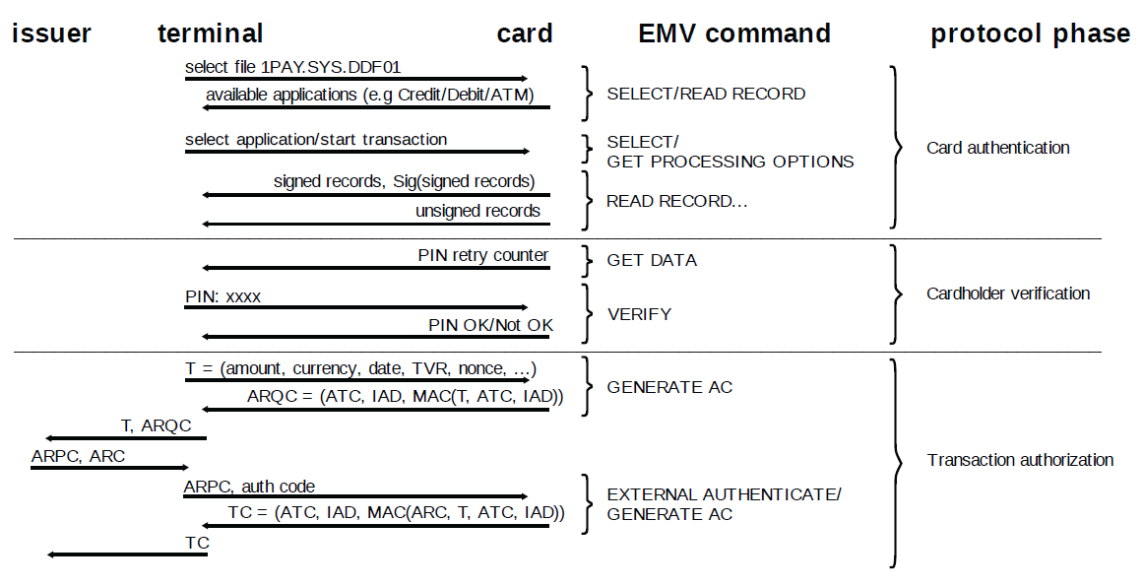
EMV: protocol
TVR: terminal verification results, ARQC: authorization request cryptogram, ATC: application transaction counter, IAD: issuer application data, ARPC: authorization response cryptogram, ARC: authorization response code, TC: transaction certificate
Notes:
Cardholder verification byte of TVR only set if verification attempted and failed.
Only failure condition records are required.

Slide 231
EMV: what went wrong
It is possible to enter an unintended state
Three parts of protocol are separated
Card authentication
Cardholder verification
Transaction authorization
Partial views paint different views of the world
TVR doesn’t specify what verification method used on success
Mainly lists failures
Compartmentalizing lets adversary build their own verification process
Notes:
Transaction not end-to-end

Slide 232
EMV: attack
Use FPGA, software, and dummy card to intercept communications with stolen card
Alter cardholder verification
Trick terminal into thinking PIN verification succeeded
Real card believes terminal does not support PIN verification
Thinks merchant verified signature
Merchant thinks PIN was verified
Protocol records don’t indicate how cardholder verification performed
No record to identify inconsistency

Slide 233
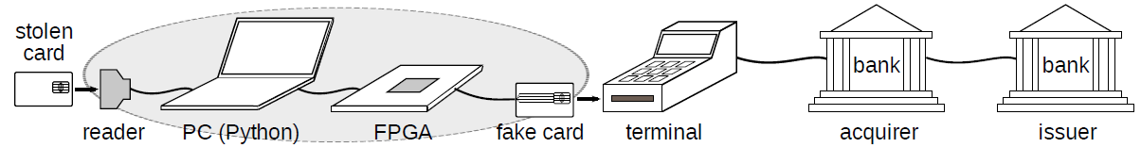
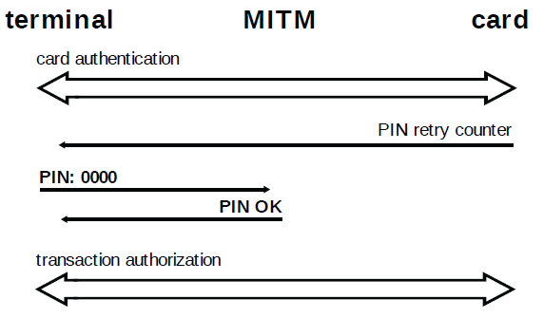
EMV: attack (continued)

Slide 234
EMV: attack (continued)
Caveats
Requires hardware for man-in-the-middle
That wiring up your sleeve might raise suspicion on a hot summer day
Authors of this paper have assisted in dispute cases where card stolen
Lucky customers have the encoded cardholder verification on receipts
Decoding shows that signature was used, not PIN
Were able to get money back
Unlucky customers (most of them) didn’t have this record
No way to show signature use
System does not provide adequate evidence

Slide 235
VOIP
Phoneme - basic building block of speech
Some VOIP protocols compress phonemes, then encrypt with stream cipher
Stream cipher encryption preserves length of message
Phonemes compress to different sizes
What does this mean for the adversary?
Notes:
Note difficulty and required skills to do this

Slide 236
VOIP: problems
Correlation between packet length and phoneme
Packet length gives information to attacker
Attacker can learn something about encrypted VOIP conversations
Who is talking
What language
What they are saying
See “Uncovering Spoken Phrases in Encrypted Voice over IP Conversations” by Wright et al.

Slide 237
KeeLoq
Remember the exercise where the remote turns on the light?
That was a simplification of KeeLoq code hopping scheme
Counter prevents replays
Instead of turning on a light, it opens your car or garage door
Attacker’s goal: open the door

Slide 238
KeeLoq: attacks
Social attacks
May gain physical access
Clone dongle
Noticeable
Can watch signals via side channel
No access to plaintext

Slide 239
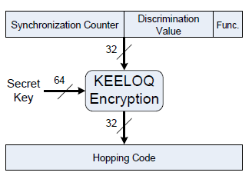
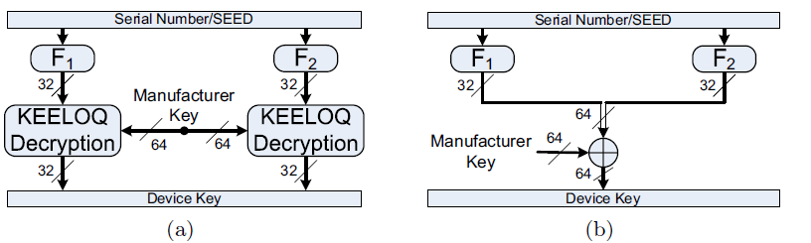
KeeLoq: device key
Device key is secret shared between receiver and transmitter
Derived using a manufacturer key
Honda, Toyota, etc.
Once you know the manufacturer key, you can spoof anything you have the serial number for

Slide 240
KeeLoq: power analysis
Differential power analysis used to find keys
Cloning transmitter
With physical access to remote
10-30 traces
Without physical access
Cloned by eavesdropping, if manufacturer key known
With device key, decrypt message to obtain fixed values and counter
Denial of service
Increment counter so that “real” remote counter is outside acceptable window

Slide 241
KeeLoq: final notes
Details in “On the Power of Power Analysis in the Real World: A Complete Break of the KeeLoq Code Hopping Scheme”
Defend against attacks with sufficiently random longer seeds
The authors found manufacturer keys
To my knowledge, have only released them to the manufacturers as proof
Only need to eavesdrop at most two message to clone a transmitter
It takes skill to pull off key extraction
Only need to use skill once to find manufacturer key
Rest can be performed by unskilled adversary

Slide 242
Standards

Slide 243
Standards
Several international standards
Some countries have their own standards
Some design internally
Some use designs from other countries
US has mix of NSA and internationally-designed crypto standards
DES, SHA-1 examples of NSA
AES, SHA-3 examples of international
Anyone who wants to do business with the US government needs to implement our standards
China likes algorithms designed in China
Needed their own stream cipher for 3G LTE (long term evolution)

Slide 244
Organizations
This is not an exhaustive list
Government organizations
i.e. National Institute of Standards and Technology (NIST), NSA
CRYPTREC (Japan)
RSA Labs
Internet Engineer Task Force (IETF)
Institute of Electrical and Electronic Engineers (IEEE)
American National Standards Institute (ANSI)
ECRYPT II

Slide 245
NIST
Computer security division provides a suite of approved cryptographic algorithms
Block ciphers
AES (advanced encryption standard)
Triple DES (also called 3DES, TDEA)
DES (flawed, deprecated)
Hash functions
SHA (flawed, deprecated)
SHA-1 (phase-out)
SHA-2 family
SHA-3 family

Slide 246
PKCS
Public key cryptography standards
RSA labs
RSA standards (PKCS #1)
Encryption and signatures
Diffie-Hellman key agreement (PKCS #3)
Password-based cryptography (PKCS #5)
Elliptic curve cryptography (PKCS #13)
And more
RSA, part of EMC corp.
RSA, the algorithm

Slide 247
IETF
Protocol standards
Transport Layer Security (RFC 5246)
Kerberos (RFC 4120)
Secure Shell Transport Layer Protocol (RFC 4253)
Extensions to protocols
Crypto algorithm standards
Camellia (RFC 3713)
Also a good source of April fools jokes

Slide 248
Selection by competition
Trend towards competition-based standards selection
Selection committee puts out a call for submissions
All submissions meeting requirements are available for public scrutiny
Submitter’s attack each other’s proposals
Benefits
Access to best cryptographers and cryptanalysts in the world
Free labor for selection committee
Papers and dissertations for academics
Fame and glory
With a very select crowd

Slide 249
NIST competition-based projects
Advanced Encryption Standard
FIPS standard published 11/26/2001
Rijndael
Vincent Rijmen and Joan Daemen
SHA-3
Competition winner announced 10/2/2012
Keccak
Guido Bertoni, Joan Daemen, Michaël Peeters and Gilles Van Assche.

Slide 250
Other projects
NESSIE (New European Schemes for Signatures, Integrity and Encryption)
Selected symmetric and asymmetric primitives
All stream cipher submissions were defeated
eSTREAM
Stream cipher competition organized by ECRYPT
Inspired by results of NESSIE
CRYPTREC (Cryptography Research and Evaluation Committees)
Japanese Government

Slide 251
Closing Remarks

Slide 252
Summary
Cryptology is the study of codes
Cryptography is the study of designing codes
Cryptanalysis is the study of breaking codes
The only thing that should be considered secret is the key
Encryption algorithms generally fall into two categories
Symmetric
Asymmetric
Ciphers provide confidentiality
Hash functions provide integrity
MACs and digital signatures provide integrity and authentication

Slide 253
Summary (continued)
There are several types of attacks possible
Each have different restrictions and relative difficulty
An algorithm is broken when it no longer provides the security properties that it should
“Encrypted” is not synonymous with “secure”
There are several bodies that dictate standards

Slide 254
Key lessons
“the whole is greater than the sum of the parts”
You cannot just look for the best crypto
You need the right crypto for the right application, used in the right way
The entire system has properties
Some properties of the system may negate the properties provided by the crypto
There are many factors that come into play when choosing a cryptographic algorithm or protocol

Slide 255
More resources
More suggested reading
Handbook of Applied Cryptography
An excellent reference for state of the art in 1997
Available in text or digital format (http://www.cacr.math.uwaterloo.ca/hac/)

Slide 256
More resources
NIST cryptographic technology group
http://csrc.nist.gov/groups/ST/
NIST cryptographic toolkit
http://csrc.nist.gov/groups/ST/toolkit/index.html
Publications of standards and recommendations
IACR eprint archive
New papers in cryptology (not peer reviewed)
http://eprint.iacr.org/
eSTREAM project
http://www.ecrypt.eu.org/stream/

